Slide 1


CauseVox Guide for Fundraisers

Slide 2
Thank you for joining Give Local Together!
We appreciate you showing up for small, local nonprofits in the Greater Washington area this GivingTuesday :)
Please use this guide for instructions on how to set up and navigate your personal fundraiser on CauseVox, the platform that Spur Local is using for our community campaign this year. You can start accepting donations when early giving opens on November 1! The last day for GivingTuesday donations is Friday, December 6, but donations are accepted through CauseVox through Tuesday, December 31.
For any further questions, don’t hesitate to reach out to your nonprofit point of contact or Amanda Liaw, Spur Local’s Communications Manager, at aliaw@spurlocal.org or 202-838-3015 x3.

Slide 3
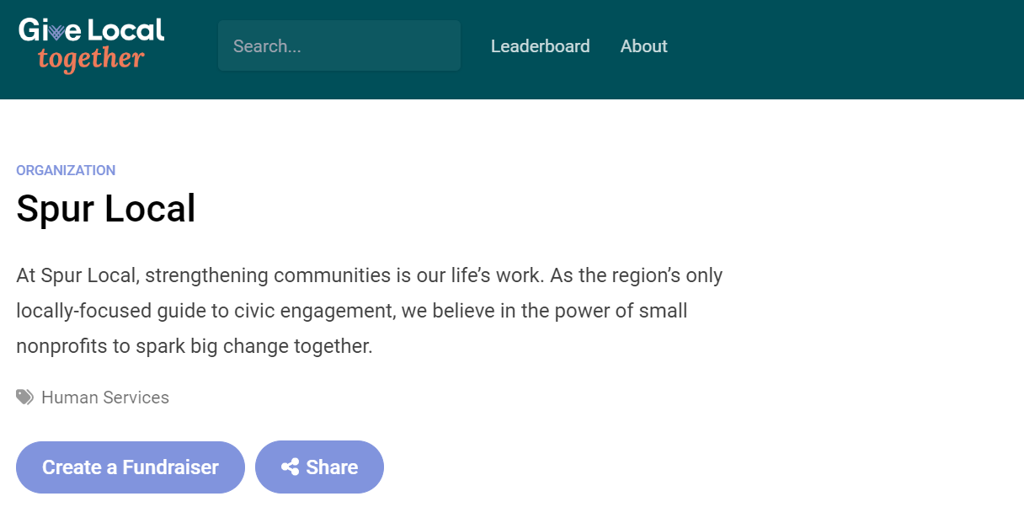
Step 1: Create an account
Visit the nonprofit page that you want to fundraise for and click “Create a Fundraiser.”

Slide 4
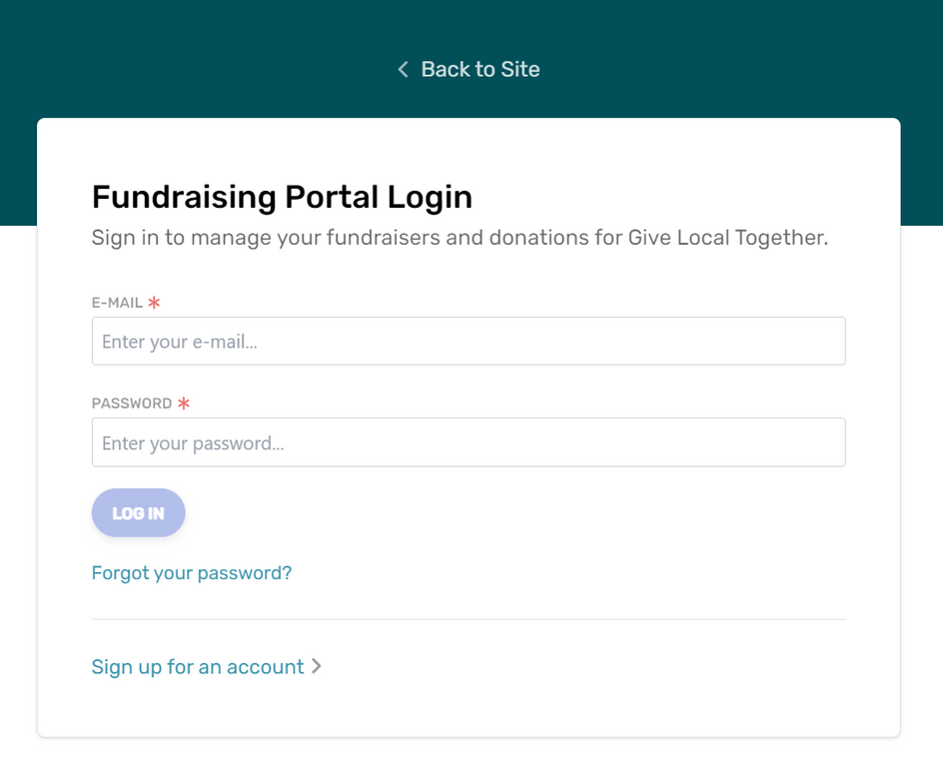
Step 1: Create an account
This will take you to a login page for CauseVox’s fundraising portal. If you don’t already have an account, click “Sign up for an account” to create one.

Slide 5
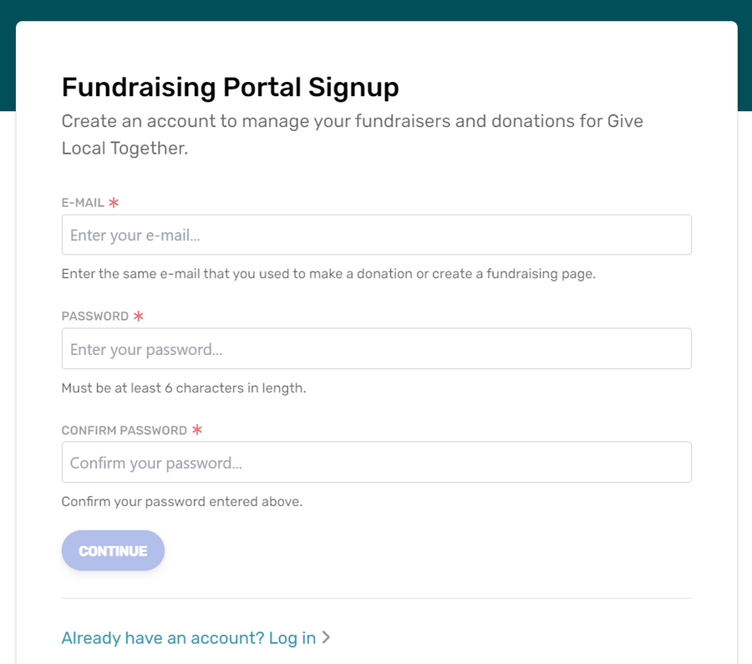
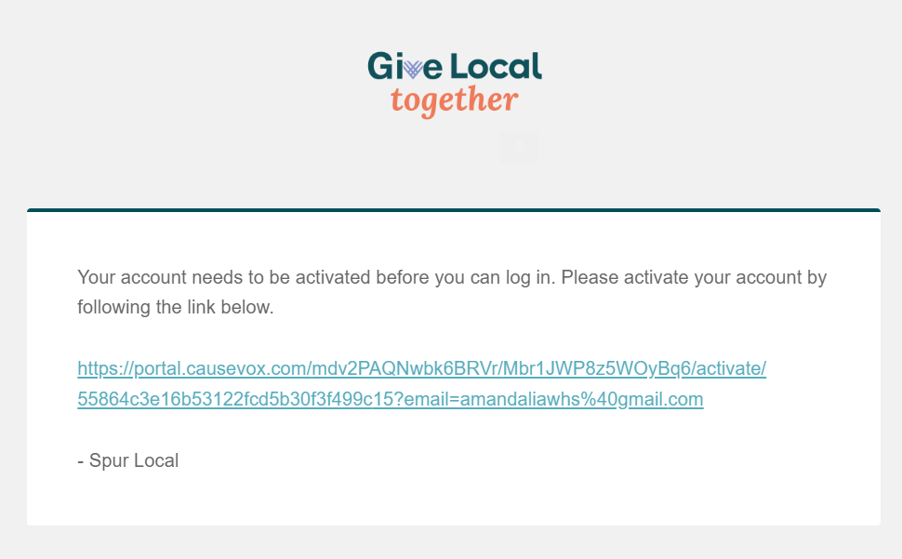
Step 1: Create an account
After you sign up for an account, you will receive an activation email from CauseVox with more instructions. *Please check your spam if you don’t see it in your inbox!

Slide 6
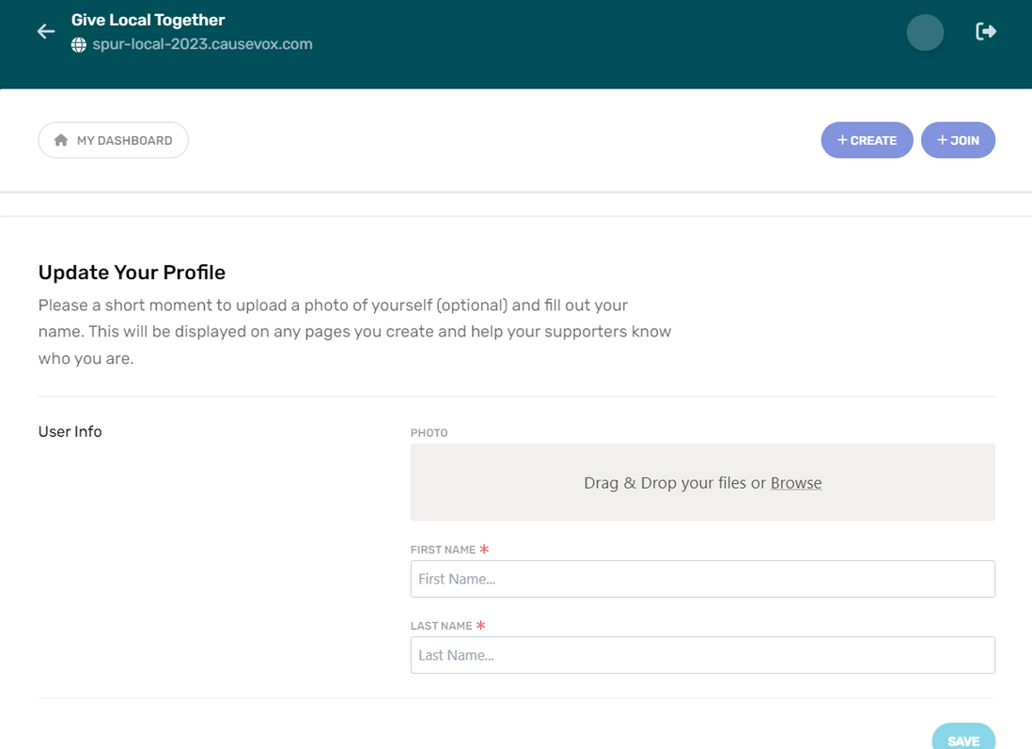
Step 1: Create an account
After you activate your account and login, you will be prompted to complete your user profile. This will show up on any fundraiser you create so that people can identify you!

Slide 7
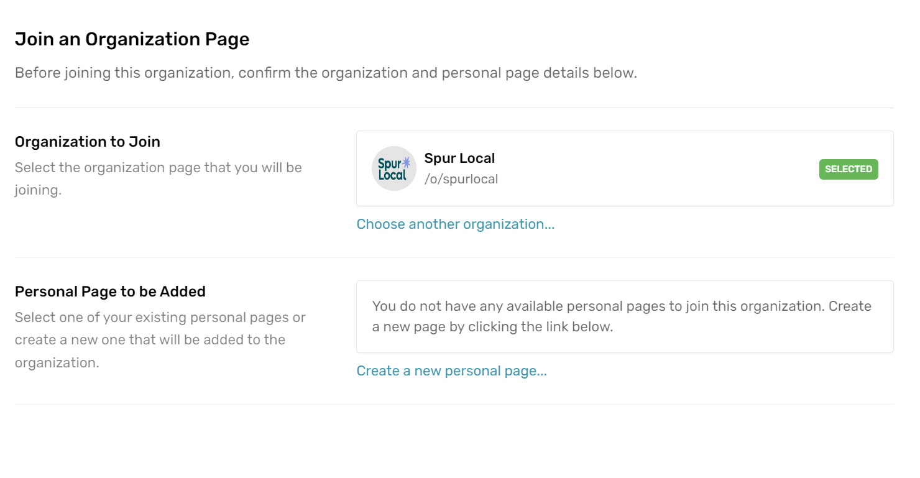
Step 2: Set up your fundraiser
Since you visited an organization’s page to create a fundraiser for them, CauseVox will prompt you to create a personal page for that organization.

Slide 8
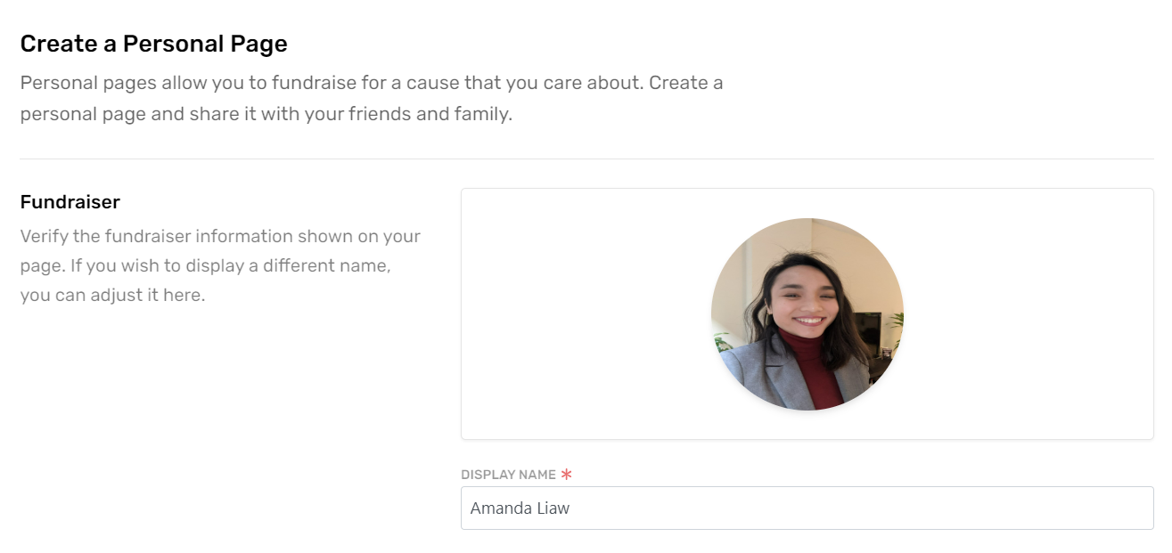
Step 2: Set up your fundraiser
At the top, you can change your display name for each fundraiser you create, but your profile photo will remain the same.

Slide 9
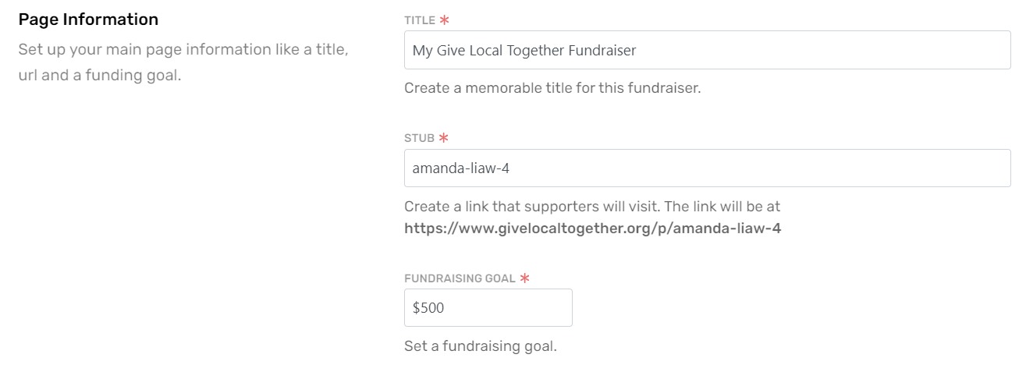
Step 2: Set up your fundraiser
There are three sections to your fundraising page. Most of these will be pre-populated for you. Please edit and adapt them to your liking!

Slide 10
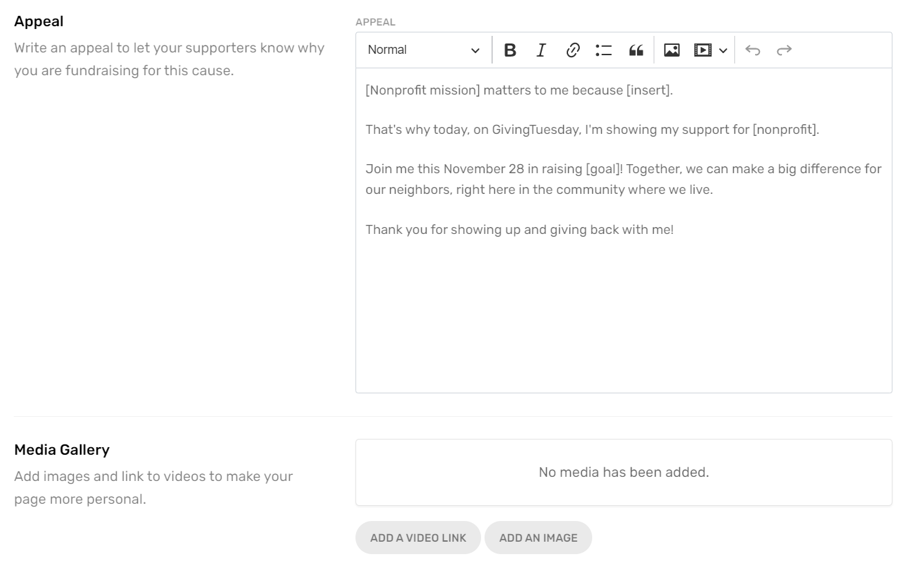

Step 2: Set up your fundraiser
You are welcome to use this appeal section to include anything else you would like people to know about when they read your page.
Where possible, we encourage fundraisers to add 2 photos and/or videos so that people visiting your page can learn about your experience with and passion for this organization!

Slide 11
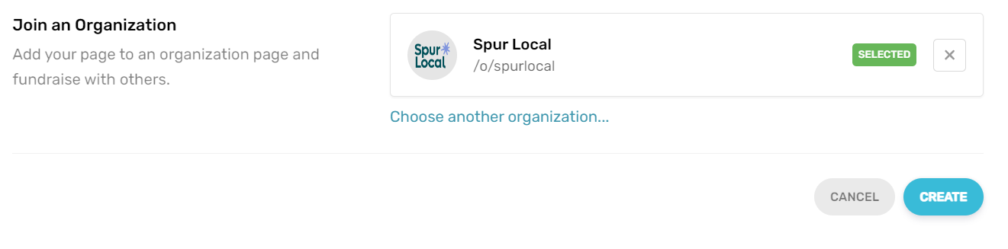
Step 2: Set up your fundraiser
At the bottom, double check that you’ve joined the correct organization you want to fundraise for. Once you’re done, click “Create” and your fundraiser page will be published and live.

Slide 12
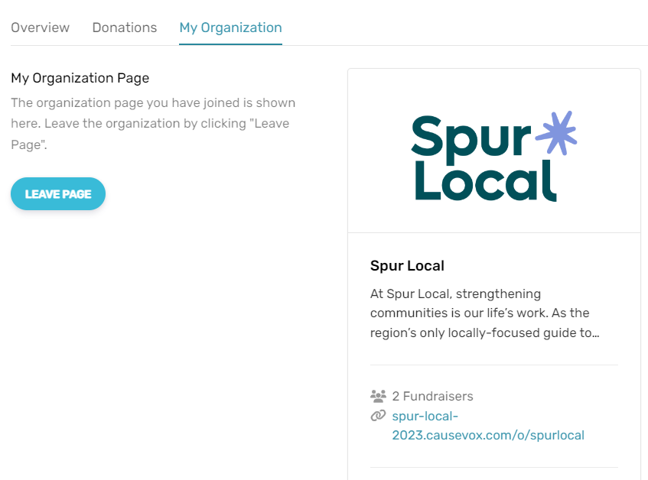
Step 2: Set up your fundraiser
You are now all set! If you have accidentally joined the wrong organization, you can click “Leave Page” and repeat the process to join the correct one. Feel free to email Amanda at aliaw@spurlocal.org with any questions as well!

Slide 13
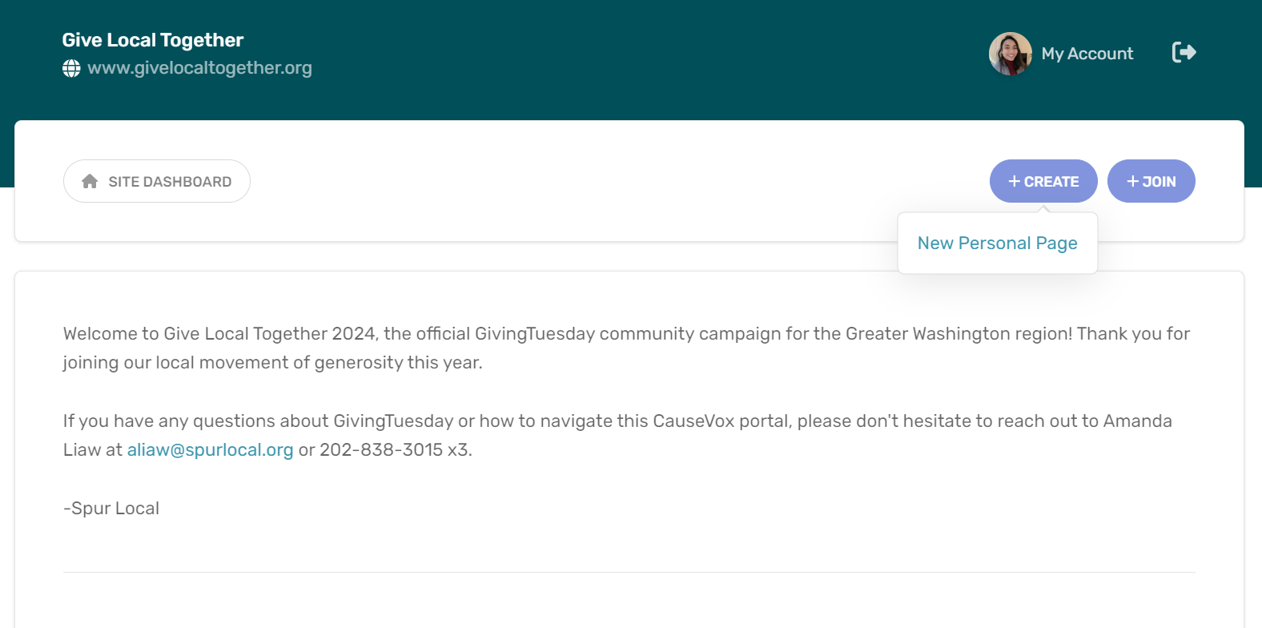
Starting within your portal
If you did not visit an organization’s page to create a fundraiser, you can also login to your CauseVox account. In your dashboard, click “Create” and “New Personal Page” to start a fundraiser.

Slide 14
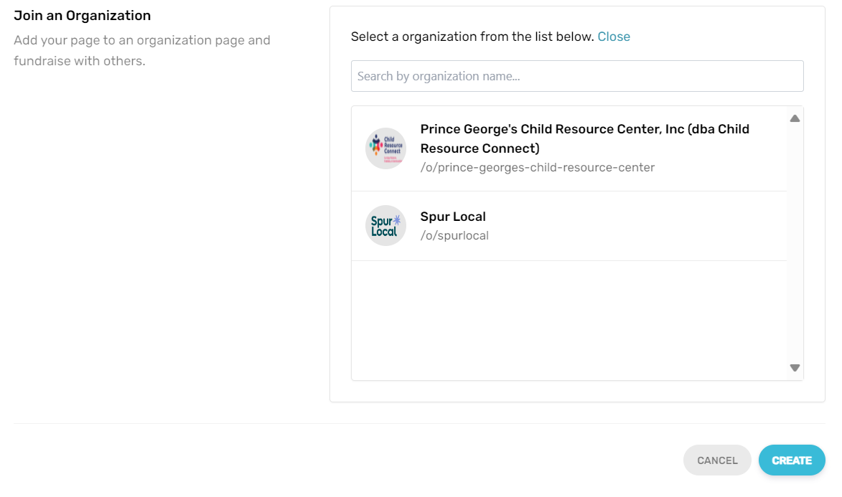
Starting within your portal
This will take you to the same “Create a Fundraiser” page as before. The only difference is at the bottom, where you can connect your page to the organization you want to fundraise for. Search this list, which includes all active nonprofits participating in GivingTuesday this year, and click “Create.”

Slide 15
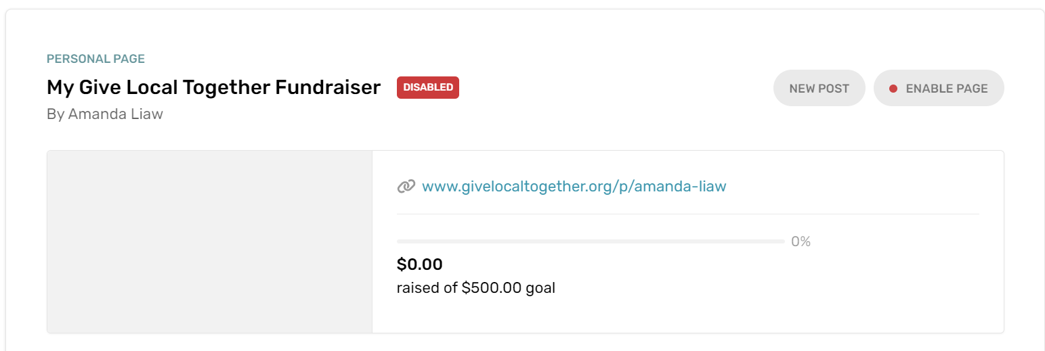
How to: Disable and preview your page
If you are not yet ready for your fundraiser page to go live, you can Disable it to take it offline while you continue prepping it. Clicking on your page link shows you a preview of what your page will look like when it’s public.

Slide 16
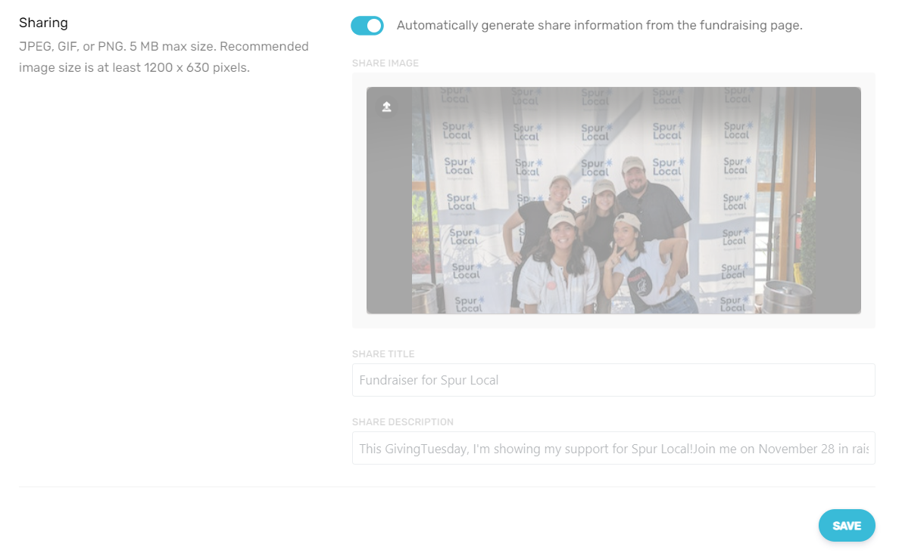
How to: Change your sharing image
In the “Overview” tab, you can edit your fundraiser page at any time. The bottom section is your Sharing image and language, which is auto-populated and will appear when someone shares your fundraiser. Untoggle to customize it.

Slide 17
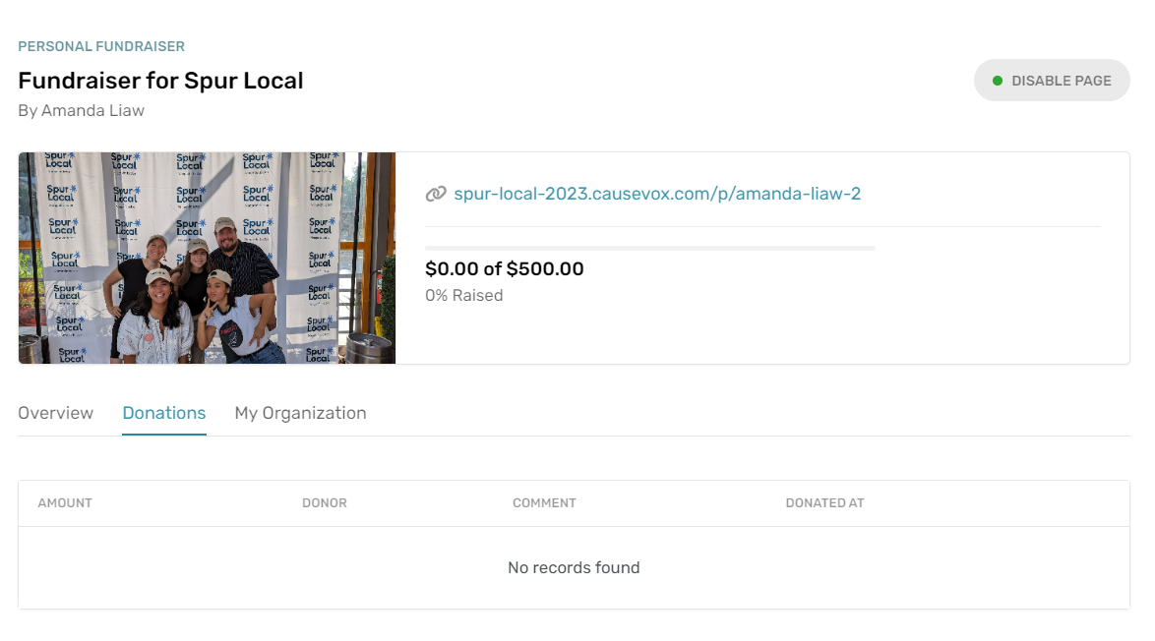
How to: View your donations
You will see donations to your fundraiser after early giving opens on November 1. Navigate to the “Donations” tab to view them.

Slide 18
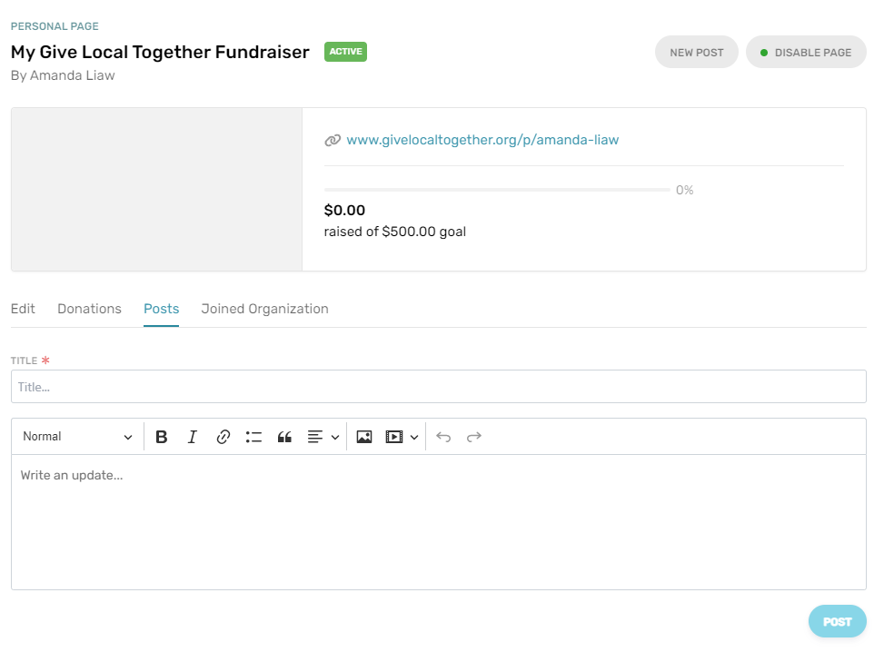
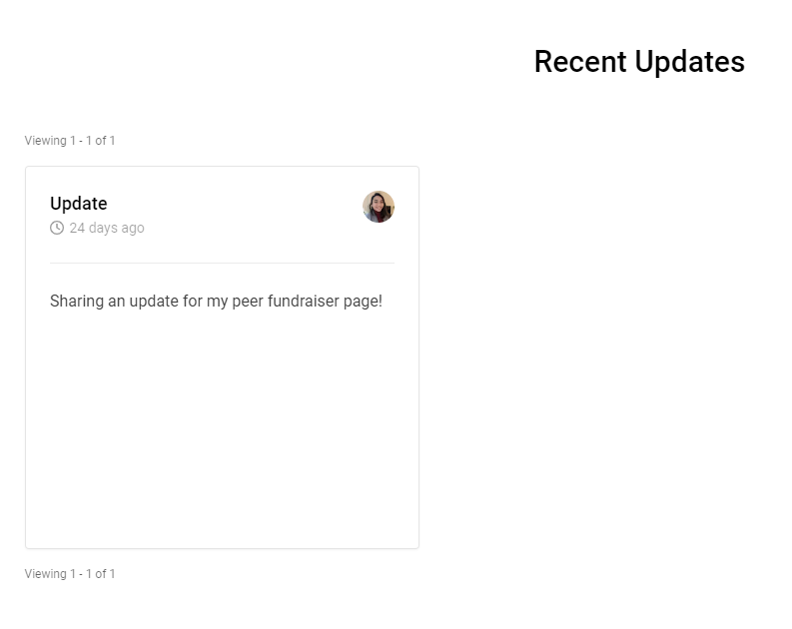
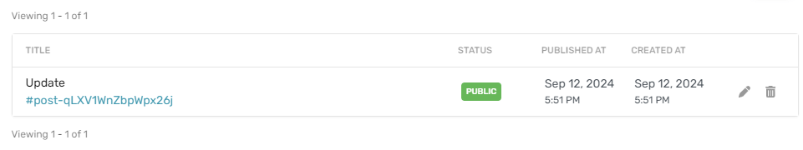
How to: Share fundraiser updates
If you have updates you’d like to share with your community, you can add posts to your public page! Navigate to the “Posts” tab or click on the “New Post” button at the top right.
Where it displays on your public page:
You can also edit existing posts at the bottom of this page.

Slide 19
Thank you for your support!

